Slide 1

Springboard Capstone Project Two Stock Price Prediction using Time Series Analysis
Author: Anshul Dikshit
Date: November 21, 2018

Slide 2


Outline
Introduction & Problem Statement
Dataset
Analysis & Findings
Machine Learning through
different Time-Series Analysis
algorithms.
Conclusions

Slide 3
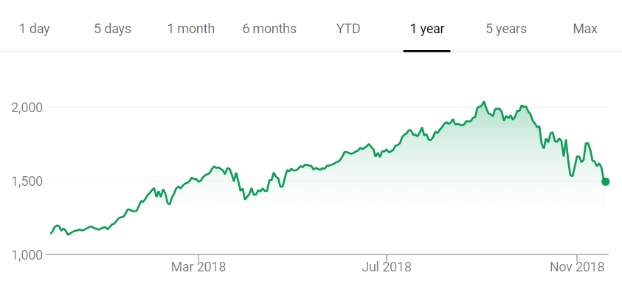
Introduction & PROBLEM STATEMENT
Making Money in stock market is every investor’s dream. There are a lot of high valued companies listed on S&P and NASDAQ which can yield high profits if their stocks are traded wisely.
THE PROBLEM
Stock market prediction is a very complex process as it depends on various factors including market sentiments, IPOs, social media announcements and others.

Slide 4
Data Set
The data has been taken from macrotrends.com which provides a starting point dataset consisting Amazon records starting from May 1997. I’ve tried to go through the process of understanding the individual variables in the data by presenting beautiful, clear, and interactive data visualizations along with some approaches to their interpretation.
Test dataset:
Train dataset:
Variable Name | Variable description
date | Date on which trade was done
open | Opening value of the stock for that day
high | High value of the stock during that day
low | Low value of the stock during that day
close | Closing value of the stock
volume | Total number of stocks traded
Variable Name | Variable description
date | Date on which trade was done
open | Opening value of the stock for that day
high | High value of the stock during that day
low | Low value of the stock during that day
close | Closing value of the stock
volume | Total number of stocks traded

Slide 5
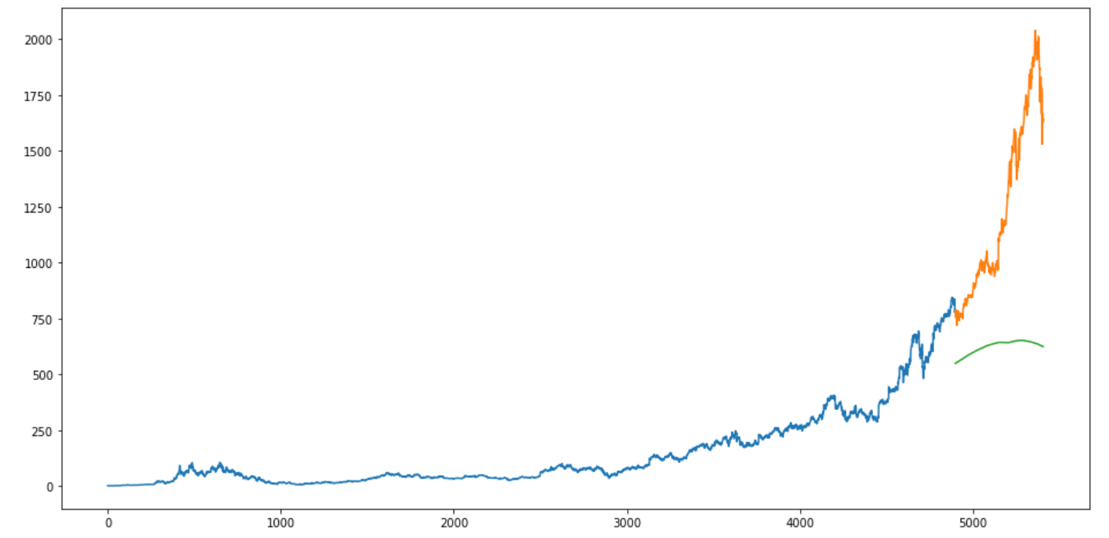
Prediction using Moving Average
The RMSE value is close to 717 and the results are not very promising (as you can gather from the plot). The predicted values are of the same range as the observed values in the train set (there is an increasing trend initially and then a slow decrease).

Slide 6
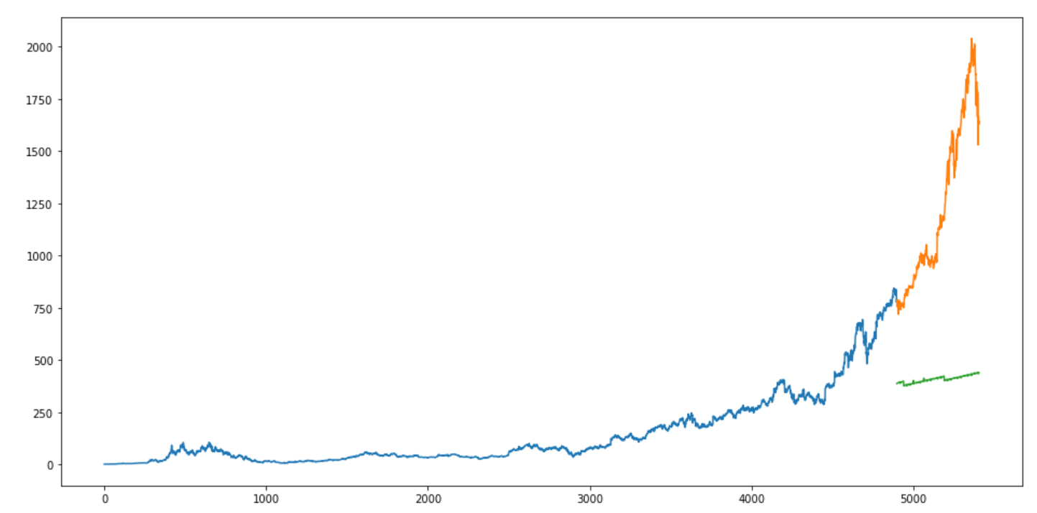
Prediction using Linear Regression
The RMSE value is higher than the Moving Average, which clearly shows that linear regression has performed poorly. Linear regression is a simple technique and quite easy to interpret, but there are a few obvious disadvantages. One problem in using regression algorithms is that the model overfits to the date and month column. Instead of taking into account the previous values from the point of prediction, the model will consider the value from the same date a month ago, or the same date/month a year ago.

Slide 7
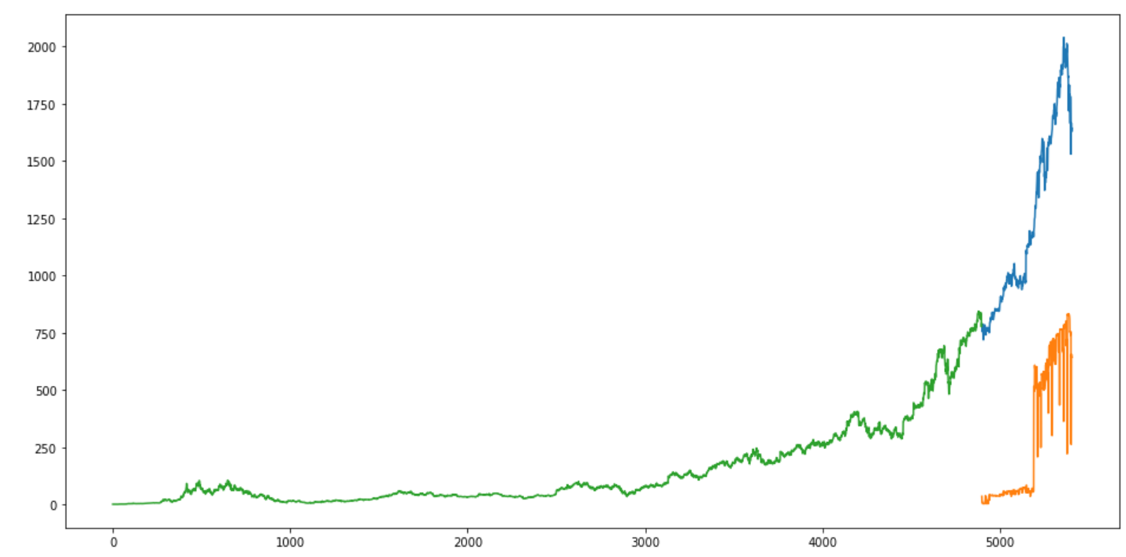
Prediction using k-Nearest Neighbours
Once again a huge RMSE of 957.12, means that k-Nearest Neighbours also did not perform well. The RMSE value is almost similar to the linear regression model, however we see that its output pattern is not very different from the actual ones. But its only the pattern, not the actual numbers. We will now move on to the next method for forecasting and see how it works.

Slide 8
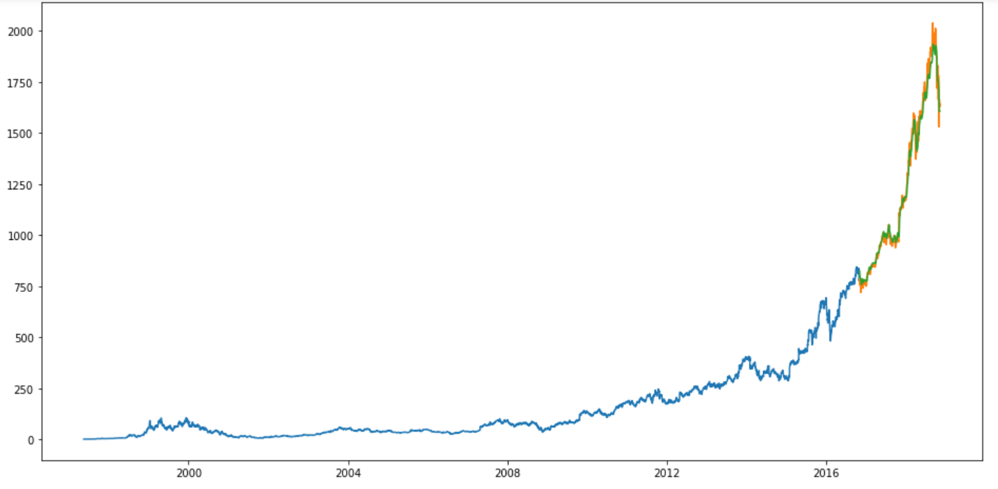
Prediction using Long Short Term Memory (LSTM)
RMSE of 40.25!!!! That’s a great reduction in RMSE. LSTM has easily outshone any algorithm we saw so far. The LSTM model can be tuned for various parameters such as changing the number of LSTM layers. But are the predictions from LSTM enough to identify whether the stock price will increase or decrease? Certainly not!
As I mentioned at the start of the presentation, stock price is affected by the news about the company and other factors like demonetization or merger/demerger of the companies. There are certain intangible factors as well which can often be impossible to predict beforehand.
As an end note, I will try to find a way to use these tangible / intangible factors as a further enhancement on my project.

